Slide 1
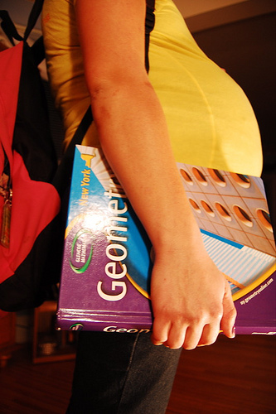
The Glamorization of Teen Pregnancy
By Kristin Howell
Trends & Issues
Fall 2010

Slide 2
Between 1991 and 2005, the United States saw a 34 per cent decrease in the birth rate among those aged 15 to 19. But in 2006, that relatively steady decline was reversed.
Among 15- to 17-year-olds, the rate was up three per cent to 22 babies per 1,000 females, and 18- and 19-year-olds jumped four per cent to 73 births for every 1,000.
Teen pregnancy is not a new issue. However it seems that it is becoming more socially acceptable. People seem have a “what’s-the-big-deal?” attitude towards the issue.

Slide 3
Pregnancy “Pact”
On June 18, 2008, news broke that 18 students at Gloucester High school in Massachusetts had become pregnant in the last year, over four times the previous year's reported pregnancies.
The principal claimed that the girls made some kind of pact to get pregnant together, one even seeking a homeless 24-year-old man in her pursuits to conceive.
Whether or not there really was a pact, these girls all knew each other and they became pregnant around the same time.

Slide 4

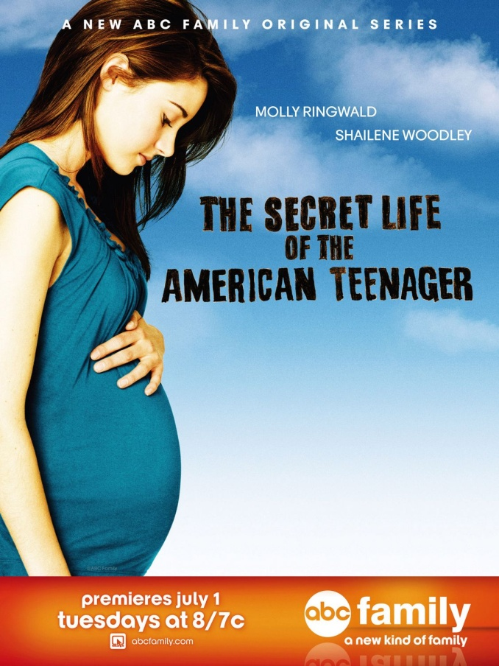
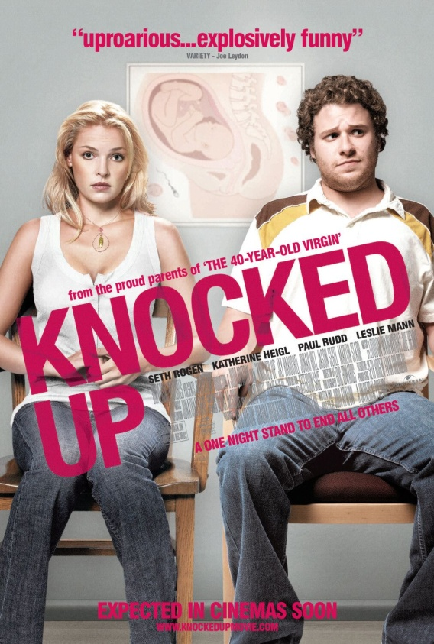
Young Unwed Mothers in Film and Television

Slide 5

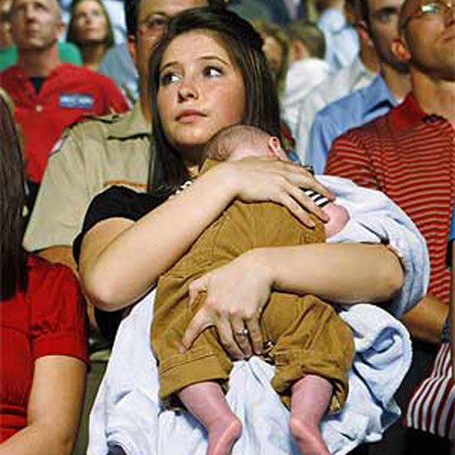
Rewarding Teen Pregnancy
Bristol Palin had a baby as a teenager and……..
…….now she’s on dancing with the stars?

Slide 6
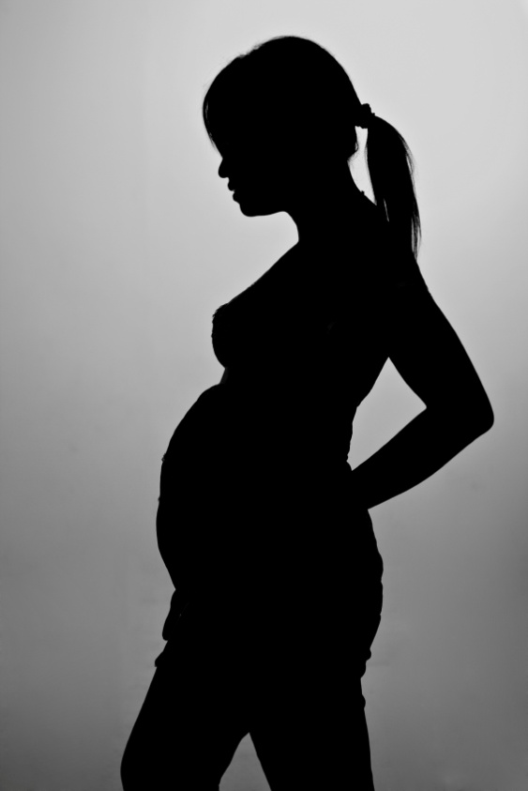
Redefining of Motherhood
Andrea O'Reilly, a women's studies professor at York University in Toronto,
believes as older women are gaining acceptance as new mothers, adolescent girls
are claiming their maternal rights too. "Teen morns are saying, why can't I be a
mother now?" "Before, the time of motherhood was so restricted. Now it's okay at 48. So why not at 18?"

Slide 7
“Multi-Daddying”
One trend observed by Pauline Paterson, director of the YWCA's girls and family programs is a phenomenon called "multi-daddying." Teen moms are actually having more than one baby with various fathers as a way of forming bonds with new men in their lives--and it's yet another way that adolescents are putting their stamp on parenthood and establishing new family models.

Slide 8
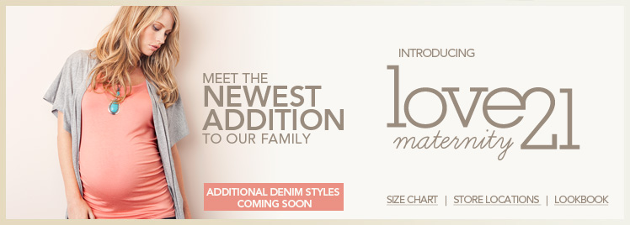
Maternity Clothing
Line for Teens

Slide 9
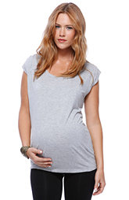
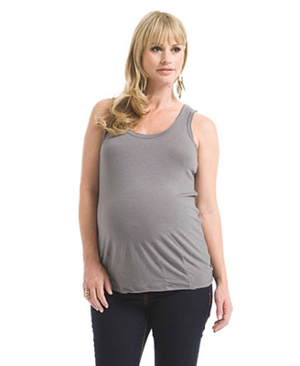
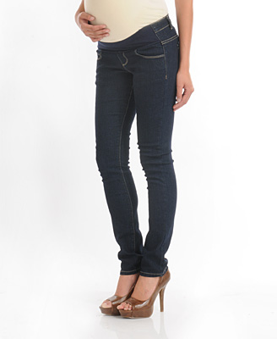
Maternity Clothing Line for Teens

Slide 10
References
Gulli, Cathy, et al. "Suddenly teen pregnancy is cool? (cover story)." Maclean's 121.3 (2008): 40. MasterFILE Premier. EBSCO. Web. 13 Oct. 2010.
NEAL, CONAN. "Teen Pregnancy: Who's to Blame?." Talk of the Nation (NPR) (n.d.): Newspaper Source. EBSCO. Web. 13 Oct. 2010.
Kingsbury, Kathleen (June 18, 2008). "Pregnancy Boom at Gloucester High“
McKay, Alexander, and Michael Barrett. "Trends in teen pregnancy rates from 1996-2006

Slide 11
Discussion

